Slide 1
Robot Project 1
Using Agile with micro:bit Robot
Face Recognition
Name: Xuanru Guo
NUIST Number: 202283890028
SETU Numser: W20109677

Slide 2
Part 1 Introduction
Project Introduction / Objective / Agile / Github
Notes:
First, let me introduce the project background.

Slide 3
Project Objective
This project aims to develop a Micro:bit-based robot capable of face recognition.
There are three core functions - all implemented using Python within an Agile development framework:
• Display numbers on an LED matrix;
• Recognize and matching faces to specific numbers;
• Secure facial data through hashing.
Apply Github to manage the development process and code efficiently
Notes:
First, let me introduce the project background.
The aim of this project is to design a smart soil moisture monitoring system using a Raspberry Pi and a digital soil moisture sensor. The system reads the real-time soil moisture status and automatically sends email notifications to users at scheduled intervals, helping users monitor their plants efficiently.
I also applied Agile methodology and used GitHub for project management and code version control, following an iterative sprint-based development approach.

Slide 4
Project Introduction
In this project, I designed and implemented a face recognition system based on a Micro:bit V2​​ and ​​K210 vision module​.
I developed the ​​face recognition system​​ that matches faces to unique IDs and implemented ​​hashing​​ to securely store biometric data.
I optimized performance to prevent ​​K210 memory overflow.
All code was version-controlled through GitHub, and I documented the full development process, from planning to testing.

Slide 5
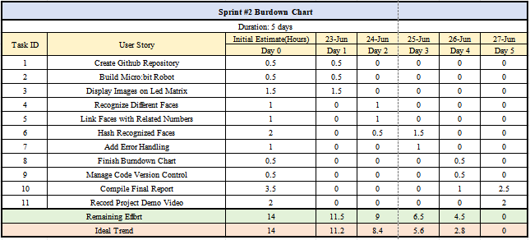
Agile process
The Burndown Chart illustrated the task and time tracking for the 7-day sprint used in Face Recognition System.
It divided development into two sprints.
Sprint 1 established Agile foundation.
Sprint 2 executed technical work.
Burn-down tables and charts documented task completion rates.

Slide 6
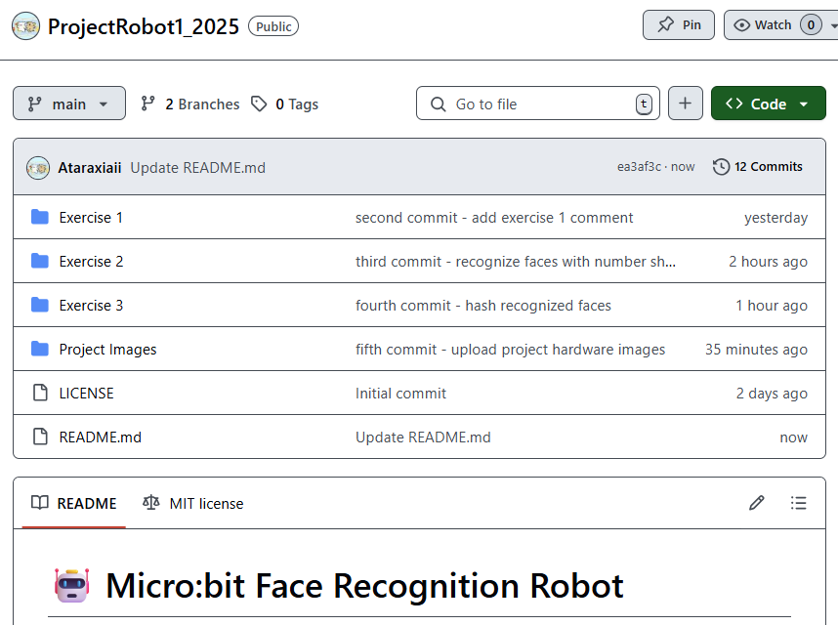
Github
The repository ProjectRobot1_2025 was created for managing the project.
The repository includes three main documents, each reflecting different stages of the system’s evolution
The README.md file provides a well-documented project description.

Slide 7
Part 2 Project Demo
Hardware Components / Connection / Code / Run

Slide 8
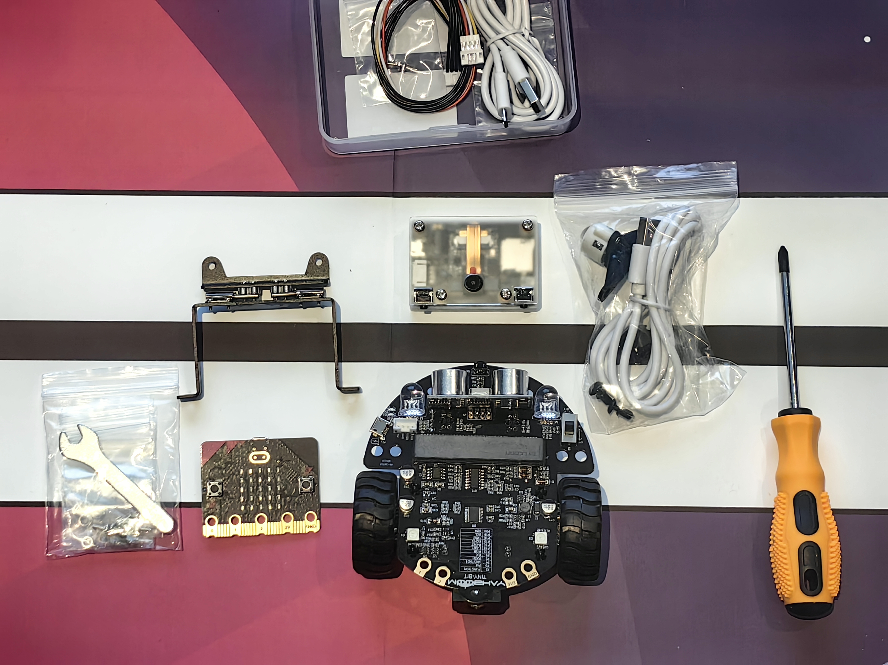
Hardware Components
Micro:bit V2
served as the central control unit
K210 Visual Module
served as the AI processing core

Slide 9
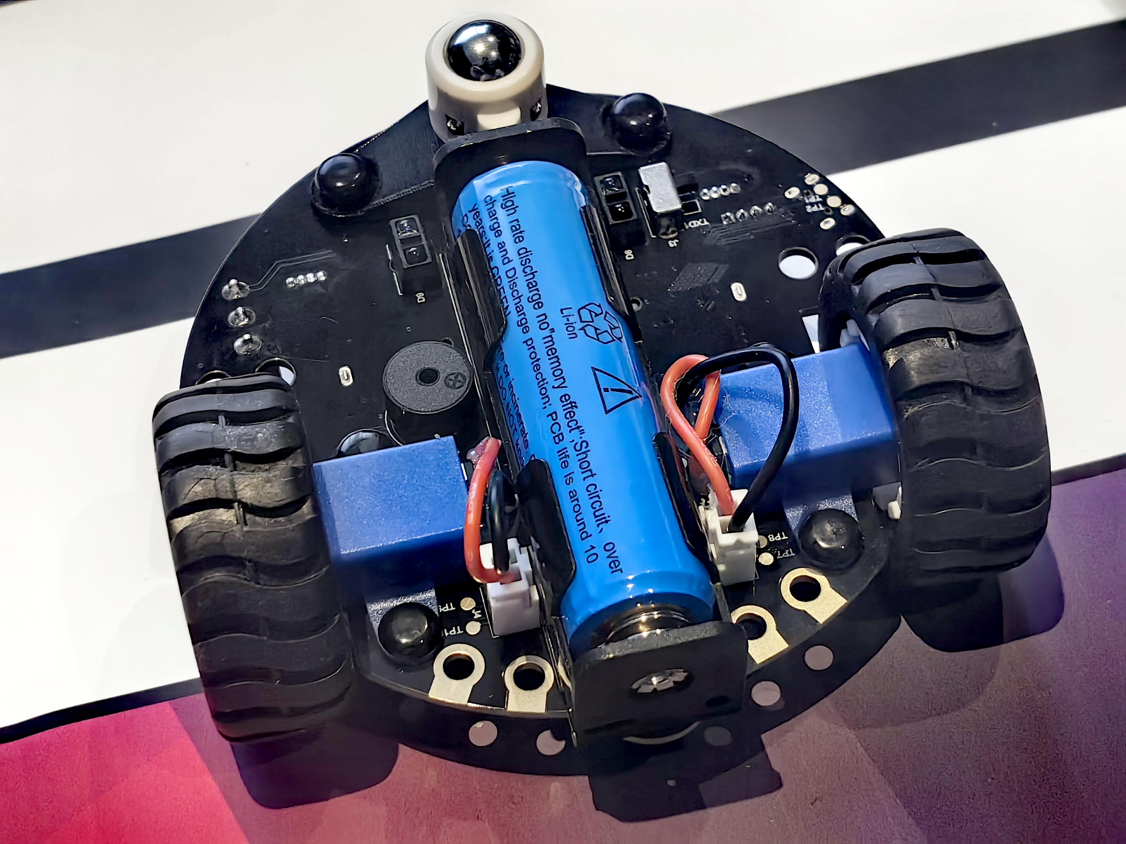
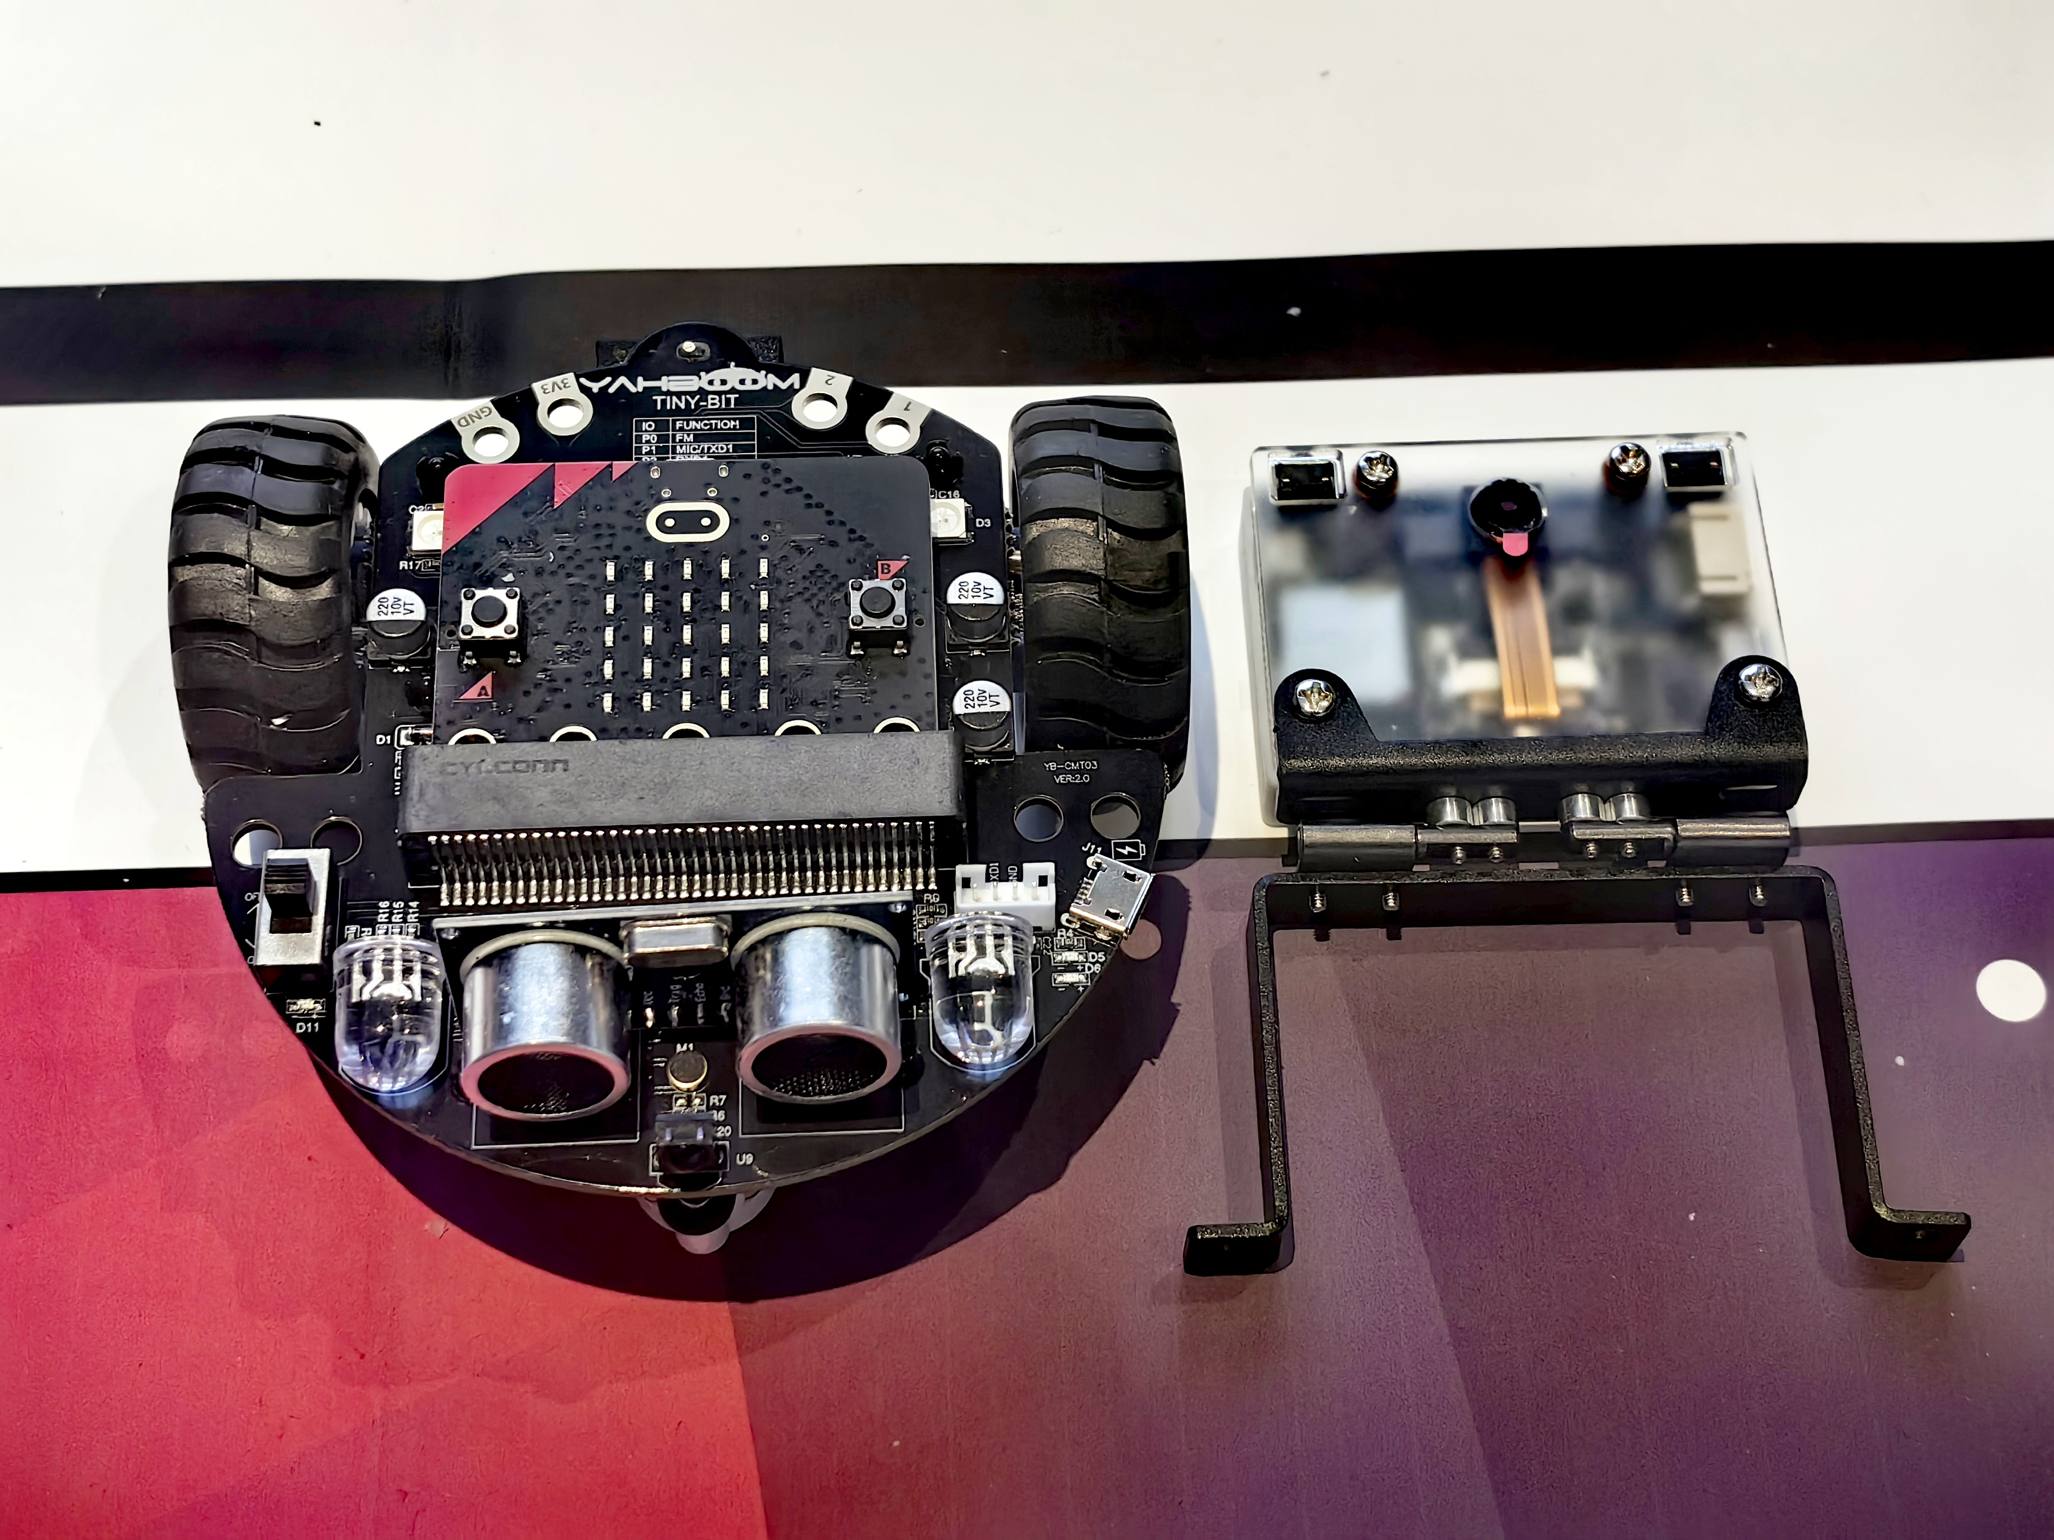
Hardware Connection
Universal wheel
Car chassis
Micro:bit V2
K210 visual module
tire
K210 visual module bracket
Lithium battery

Slide 10
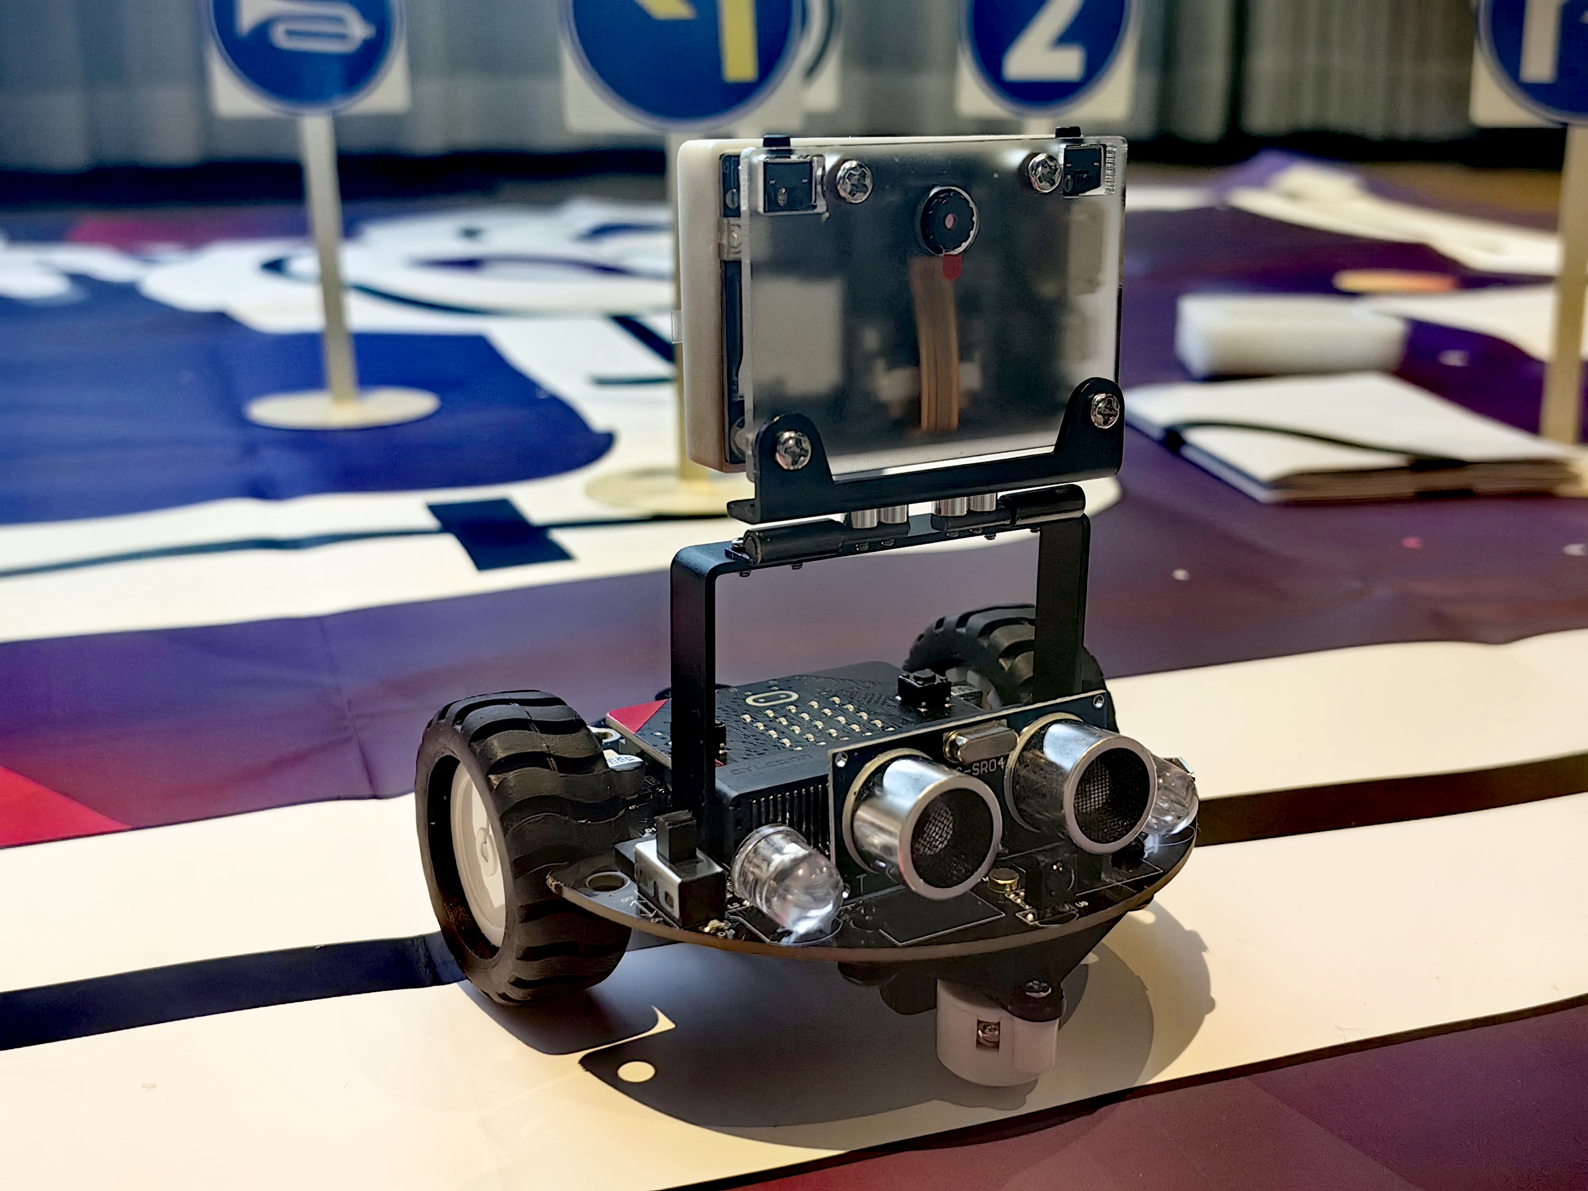
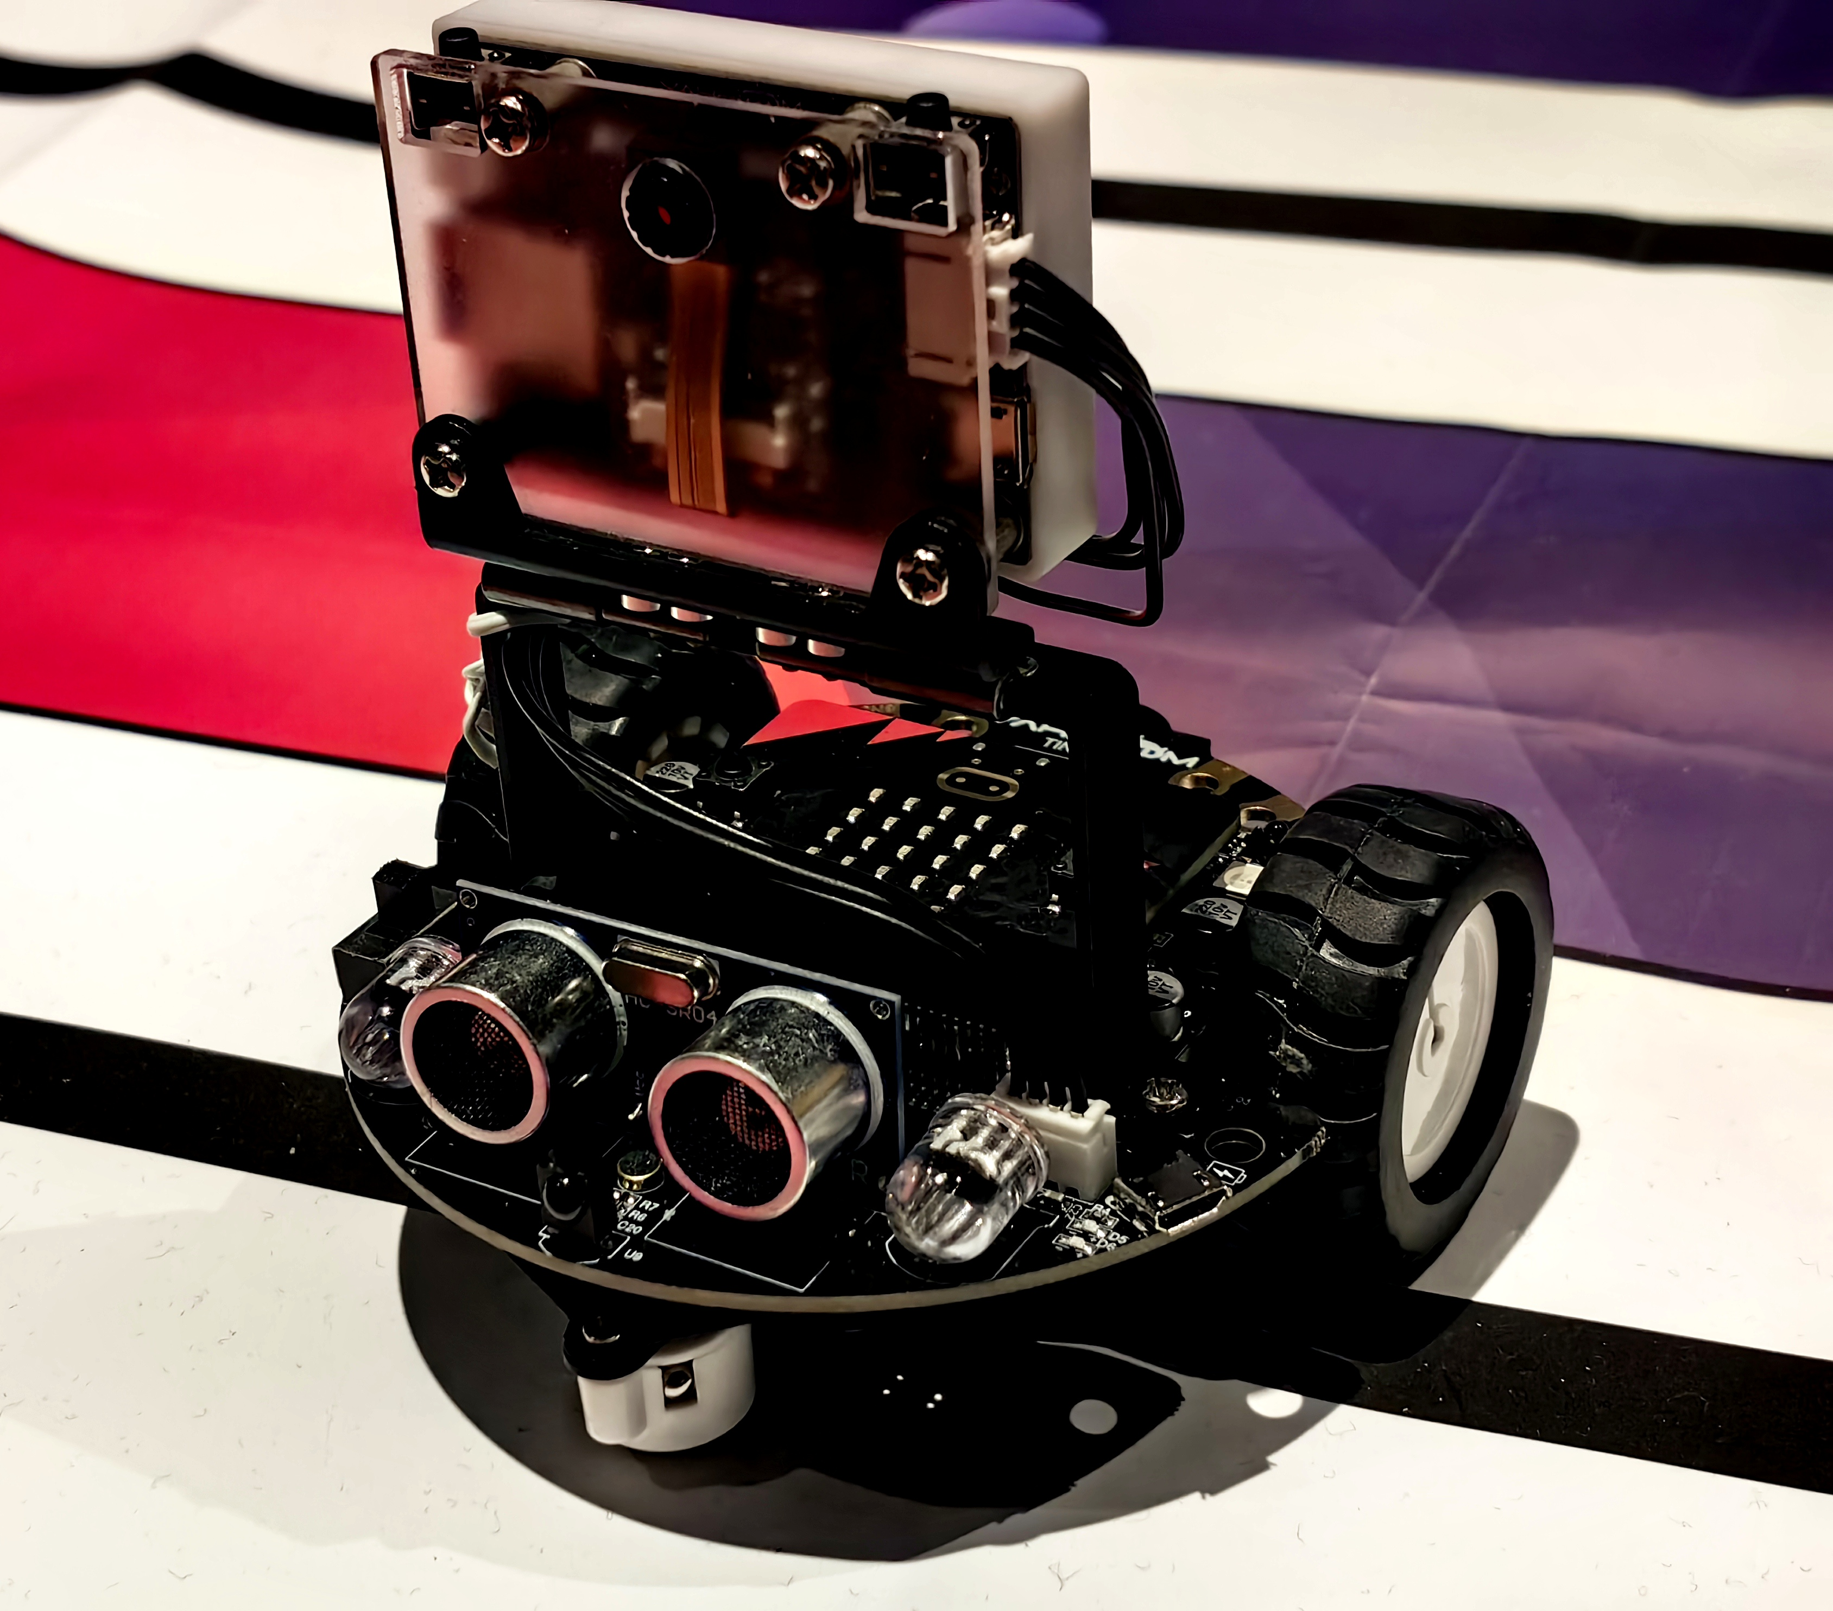
Hardware Connection
four pin cable

Slide 11
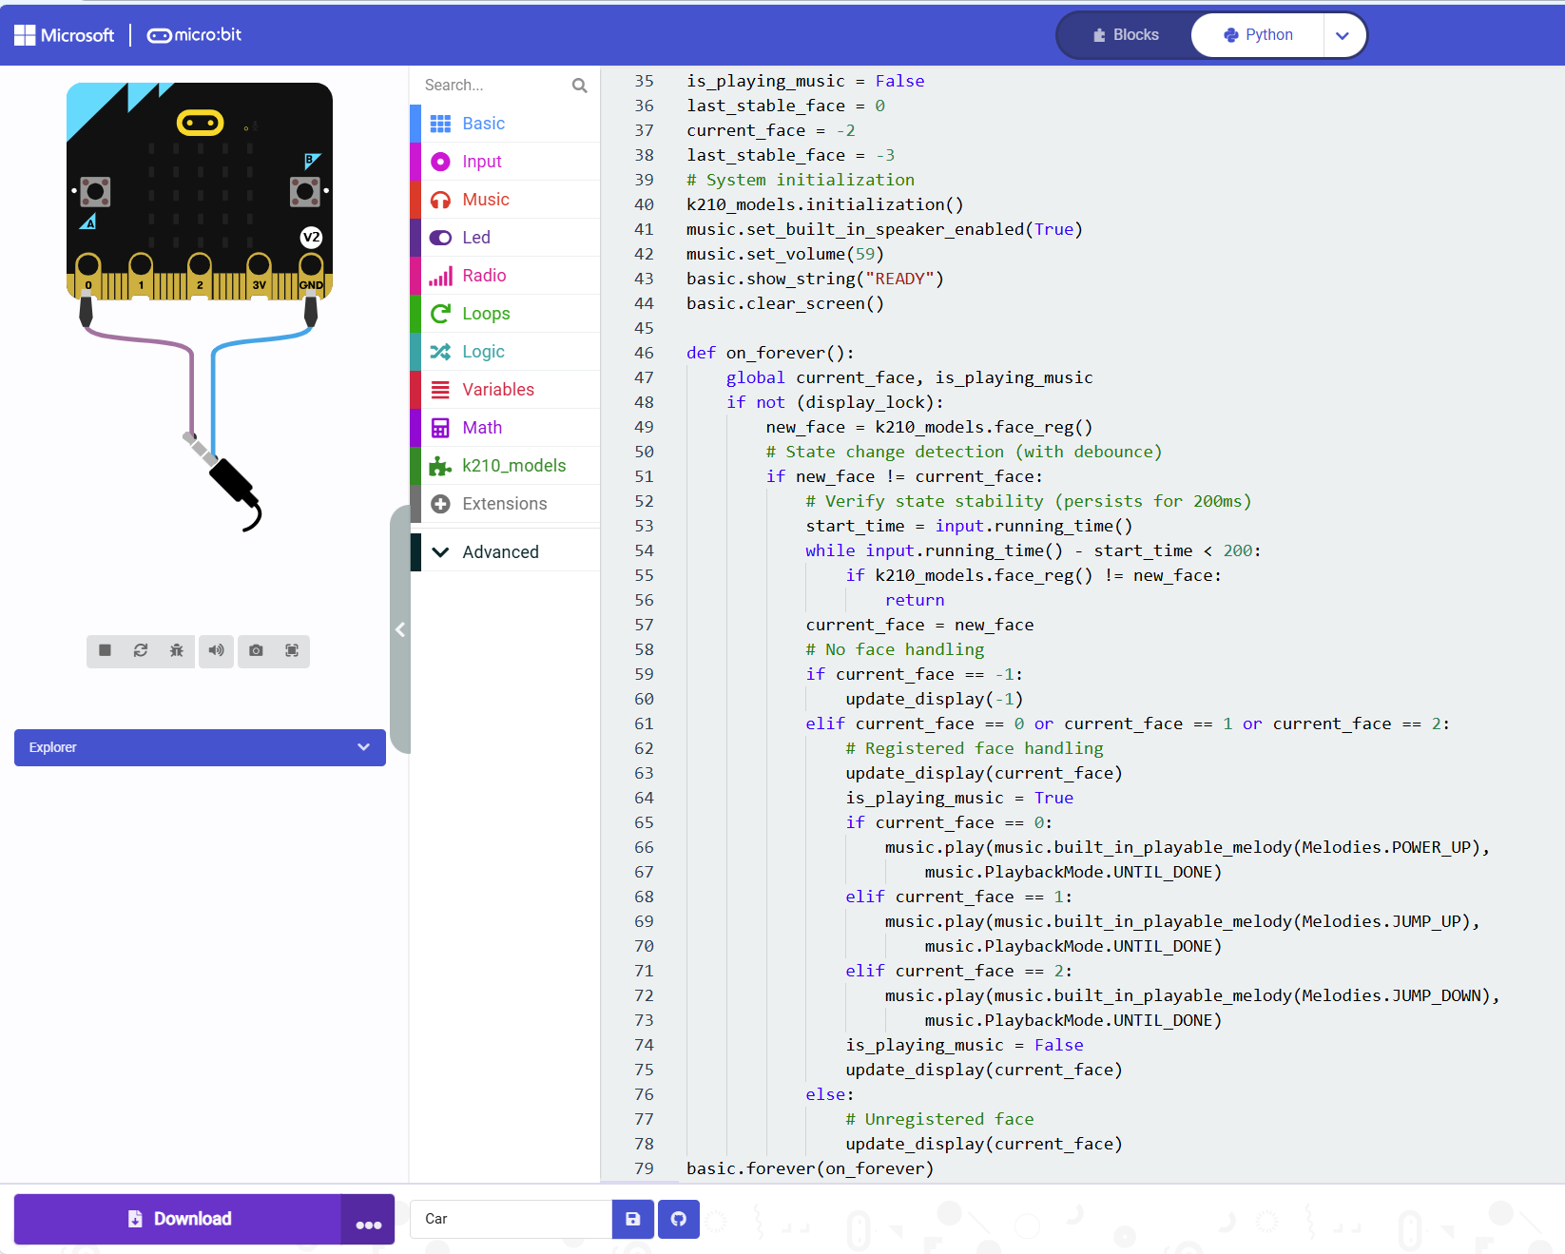
Source Code
The project’s software is composed of three main exercise scripts.
The first exercise is completed using Python script.
The second exercise uses MakeCode website and Mu Editor to finish coding.
The final optimizes data secure on the basis of exercise 2.

Slide 12
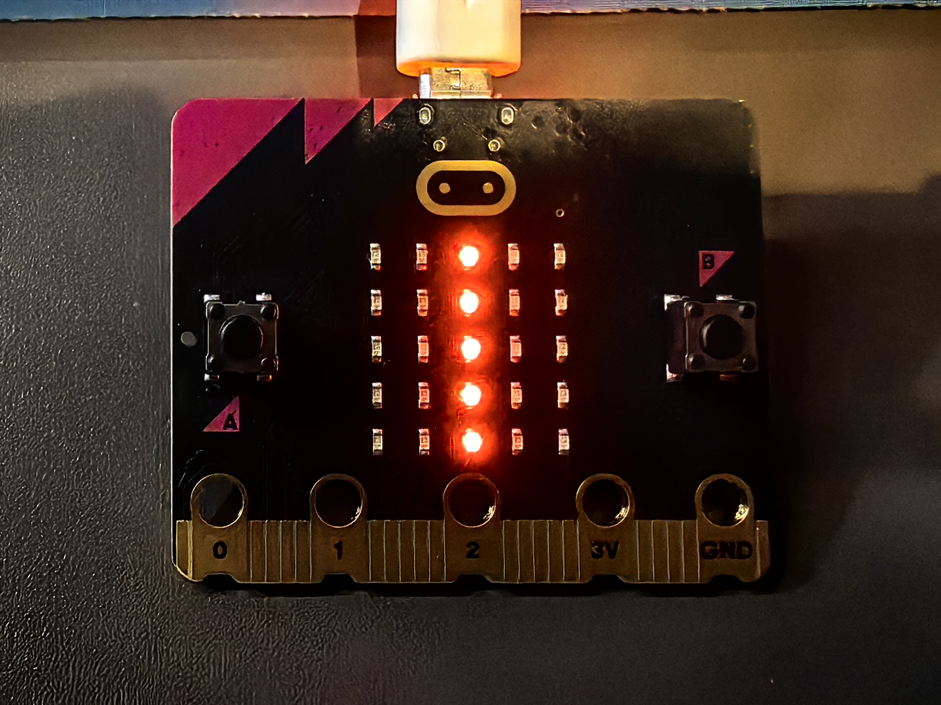
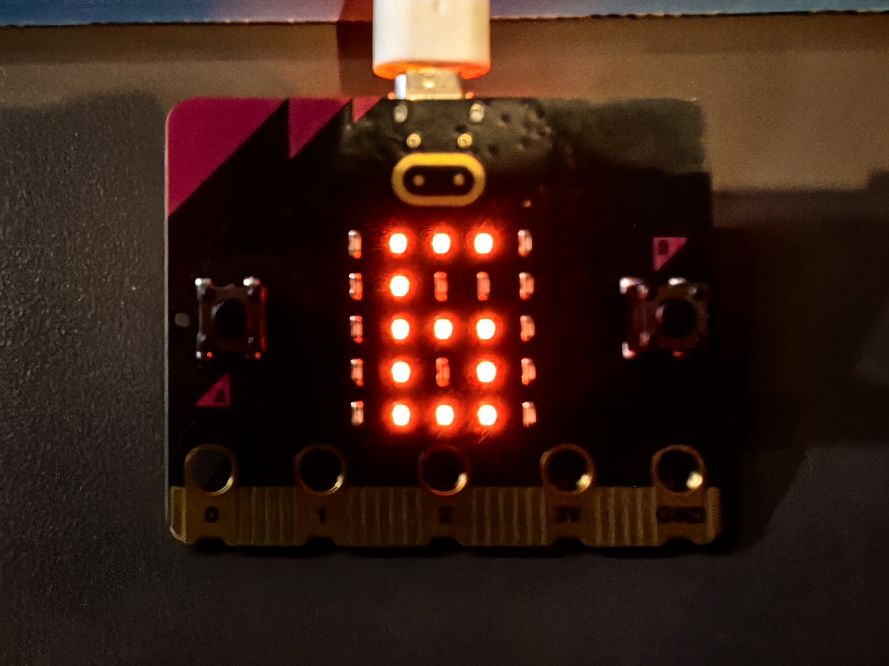
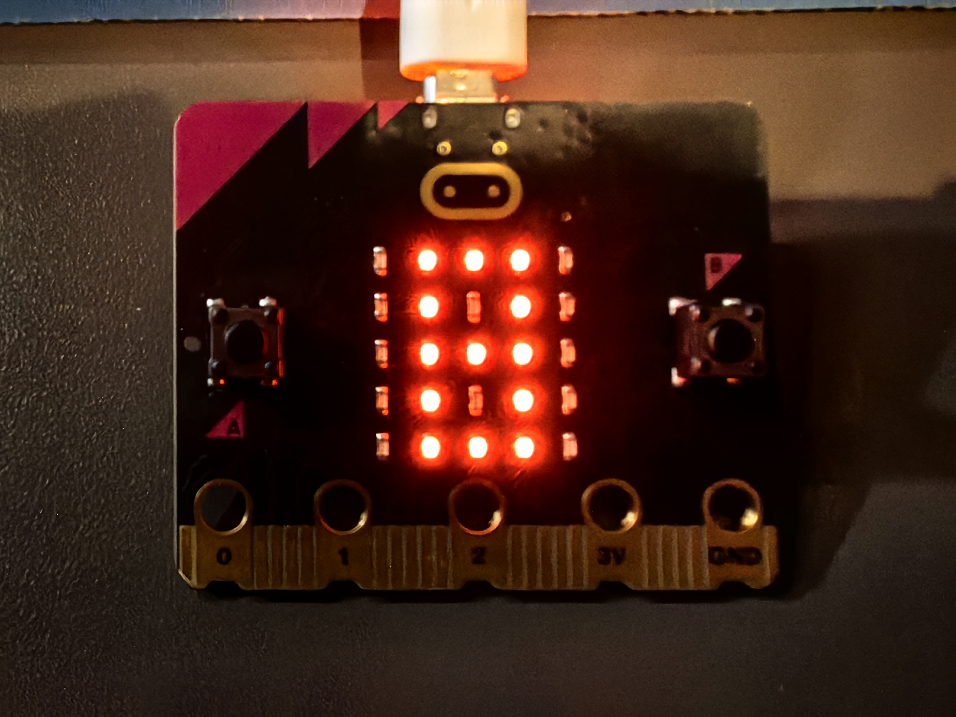
Run the Script - Display Images

Slide 13
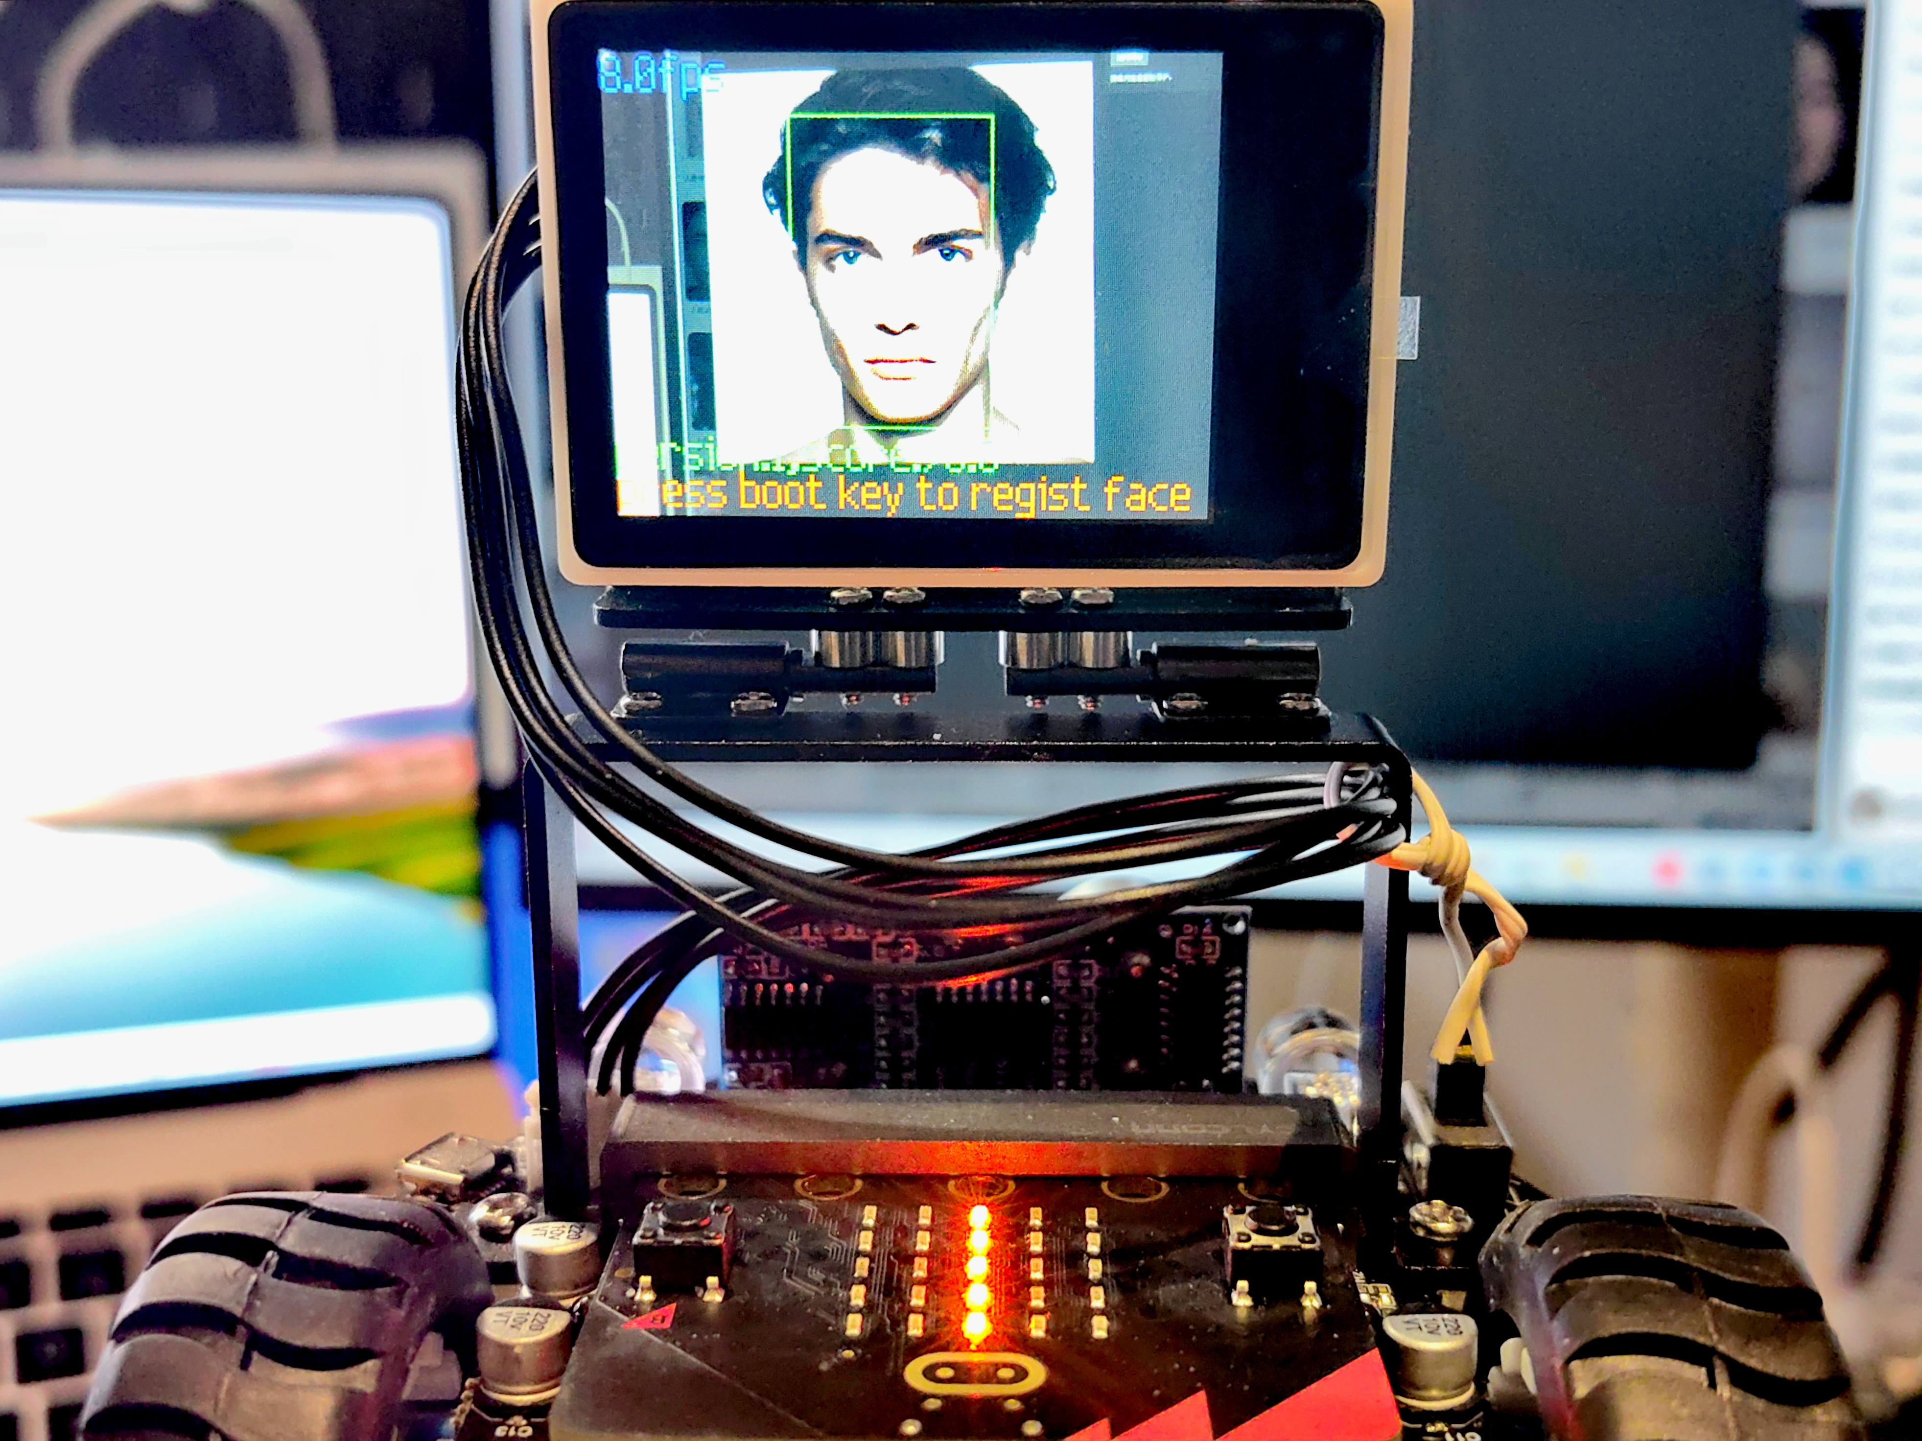
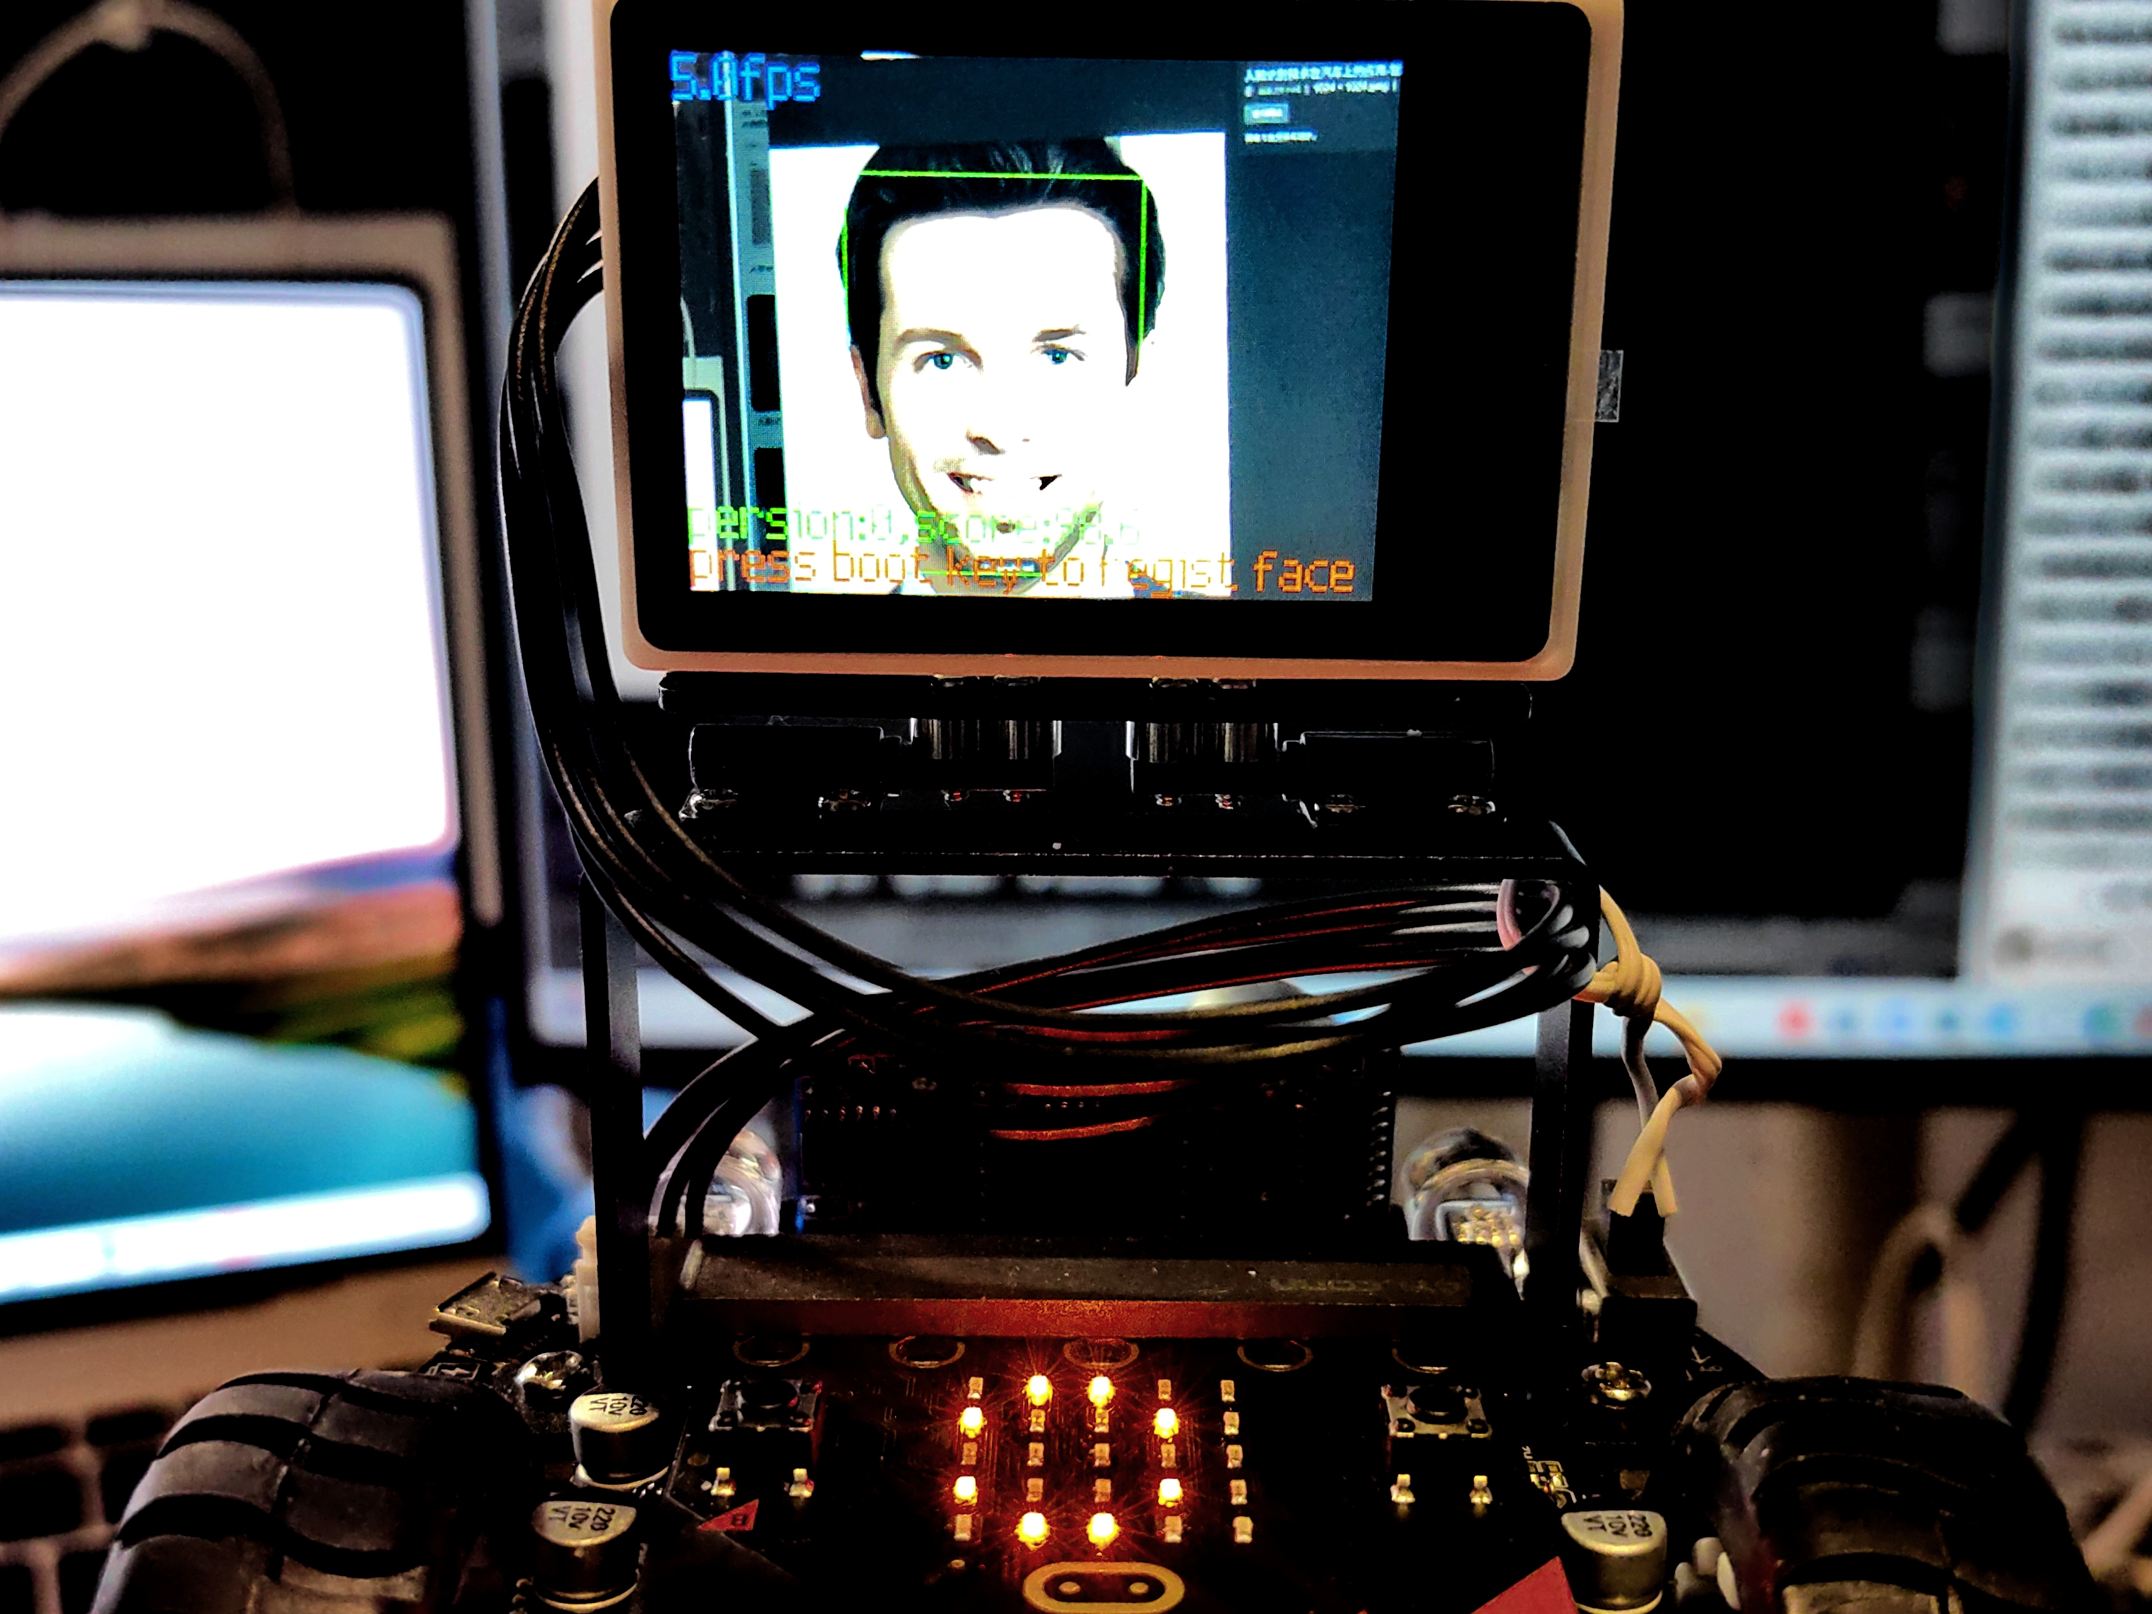
Run the Script - Recognize Faces

Slide 14
Thanks for Your Listening

